Slide 1





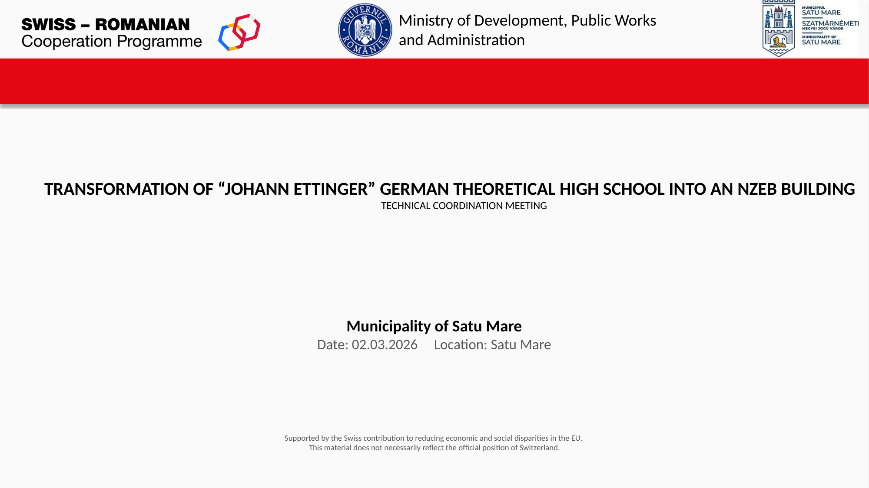
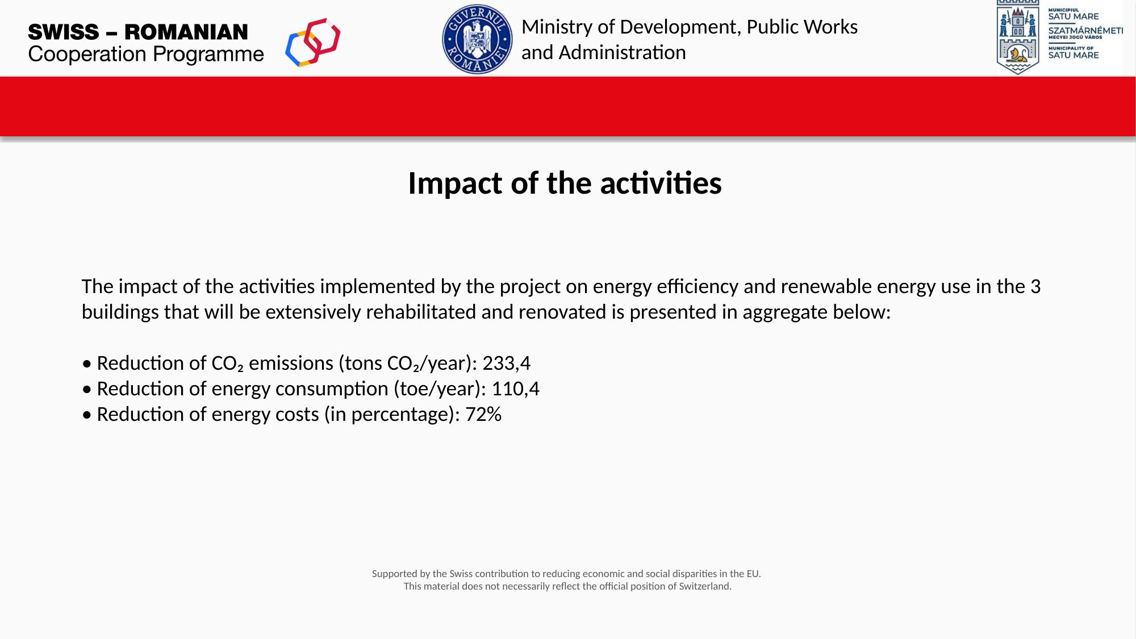
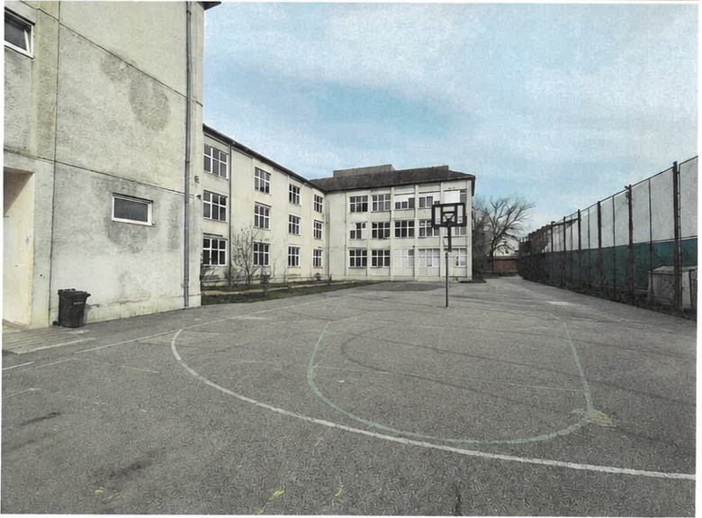
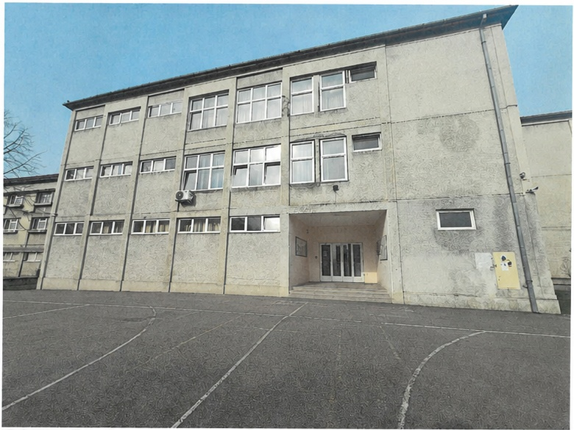

Romania projects - Proiecte în România
2. Transformation of “Johann Ettinger” German Theoretical High School into an NZEB building – Satu Mare
Satu Mare, Romania
Educational building / NZEB renovation
2029 (implementation end)
3 buildings: school, dormitory, canteen
Key information on the project:
Programme: Energy Efficiency and Renewable Energy Programme, Swiss–Romanian Cooperation Programme
Programme Operator: Ministry of Development, Public Works and Administration
Beneficiary: Municipality of Satu Mare
Budget: 38,091,429.47 lei (7,107,405.58 CHF)
Period: 03.10.2025 – 31.07.2029
Main objective: Transform the high school into a sustainable, safer, healthier NZEB building with a significantly reduced carbon footprint.
Main measures: thermal envelope, joinery, heat pumps, fan coil units, heat-recovery ventilation, LED lighting with sensors, photovoltaic panels and BEMS.
Expected project impact: −233.4 t CO₂/year, −110.4 toe/year, −72% energy costs.
Innovation: kinetic platform / kinetic musical stairs and weather-responsive heat pump operation connected to energy management.

Slide 2


Romania projects - Proiecte în România
Lessons learned and feedback - Lecții învățate și feedback
Strengths / Successes
Points of vigilance / difficulties
• Extensive renovation of a group of 3 buildings (C1 School, C3 Dormitory and C6 Canteen) through a unified technical approach.
• Strong quantified results: −233.4 t CO₂/year, −110.4 toe/year and around −72% energy costs at project level.
• Integrated technical package: envelope insulation, efficient HVAC, heat-recovery ventilation, LED lighting, PV panels and BEMS.
• Clear social impact: healthier indoor environment for over 930 students and more than 50 teachers each year.
• Innovation has an educational role: kinetic energy solutions and smart, weather-responsive heat pump operation make sustainability visible to students.
• Coordination is critical because works cover school, dormitory and canteen buildings with different uses and operational constraints.
• Procurement should verify contractor capacity for NZEB-level envelope works, heat pumps, ventilation, PV and BEMS integration.
• Design-stage coordination is needed to avoid conflicts between HVAC, electrical systems, renewables and architectural/structural constraints.
• Commissioning, calibration of BEMS and staff training must be planned early, otherwise performance gaps can appear after handover.
• Works phasing must protect student safety, continuity of school activities and indoor comfort during the intervention period.
Takeaways for future projects
For future public-school NZEB renovations, energy performance should be designed as an integrated system from the beginning: envelope, HVAC, ventilation, renewables, automation and user behaviour must be coordinated in one commissioning strategy. The Satu Mare project also shows that innovation is most valuable when it supports both energy performance and education, making pupils and staff active participants in the building’s efficiency.

